Slide 1
Lesssons learned from UseR! 2019
Alex Sánchez
Pol Castellano

Slide 2
Why this talk
UseR is an exceptional occasion
to meet with R users of all levels of expertise
to discover tòpics and tools we might ignore
To see what's going on in the R-universe
The quantity of materials available is overhelming
Goal:
Gentle introduction to UseR and to this year's materials
See also https://ryo-n7.github.io/2019-07-21-user2019-reflections/

Slide 3
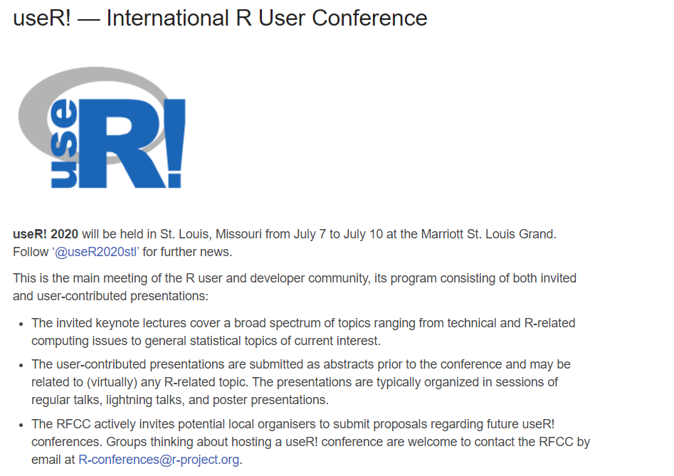
What is UseR!

Slide 4
Recent UseR! meetings
Usually, no proceedings are published for useR! conferences.
useR! 2019, Toulouse, France.
useR! 2018, Brisbane, Australia. (local copy).
useR! 2017, Brussels, Belgium. (local copy).
useR! 2016, Stanford, CA, USA. (local copy).
useR! 2015, Aalborg, Denmark. (local copy).
useR! 2014, Los Angeles, CA, USA. (local copy).
useR! 2013, Albacete, Spain (local copy).
useR! 2012, Nashville, TN, USA (local copy).
useR! 2011, Coventry, UK (local copy).
useR! 2010, Gaithersburg, MD, USA. (local copy).
useR! 2009, Rennes, France (local copy).
useR! 2008, Dortmund, Germany (local copy).
useR! 2007, Ames, IA, USA (local copy).
useR! 2006, Vienna, Austria (local copy).
useR! 2004, Vienna, Austria (local copy).

Slide 5
Types of activities
Developer's day
Tutorials
Keynotes
Talks
Lightning talks
Posters

Slide 6
UserR! materials are free
Slides are available fom the conference website
http://www.user2019.fr/talk_schedule/
Keynotes are recorded and available from R consortium Youtube channel
https://www.youtube.com/channel/UC_R5smHVXRYGhZYDJsnXTwg
Tutorials are available from this github repo
https://github.com/sowla/useR2019-materials

Slide 7
Pre-conference Tutorials
Short half-day session about "hot stuff"
Don't see them as "intended for you to to learn",
But useful to "get you introduced into the tòpic"
Some tutorials repeated along several years (life cycle)
Rise→ Grow→ Become Standard / Fade away
Our out-of-the bag choice
Package Development https://rstd.io/pkg-dev ☺
Docker for Data Science: R, ShinyProxy and more ☹☹
Introduction to generalized non linear models ☺

Slide 8
Conference tracks
Keynotes (invited talks)
Applications
Bioinformatics
Data Handling
Education
Models
Movements & Transport
Multivariate Analysis
Reproducibility
Shiny
Social science marketing & business
Biostats & Epidemiology
Community & Conferences
Data mining
Forecasting
Numerical methods

Slide 9
Conference tracks
Programming
Open Science, education & community
Operation & Data products
Spatial & Time series
Text Mining
Workflows & development
Big/high-dim data
Contribution & collaboration
Methods & collaboration
Performance
Shiny & Web
And don't forget POSTERS

Slide 10
Selected talks (day 1)
R for better science in less time
Golem: Framework for building Robust ... Shiny Apps
Shiny app deployment and integration into a custom website gallery
Enhancements to data tidying (Hadley wickham)
The "Rmd first": when projecs start with documentation
A missing value tour in R (Julie Josse, FactoMineR)

Slide 11
Selected talks (day 2)
Shiny's Holy Grail: Interactivity with reproducibility
Transitioning between various RMarkdown packages for workflow optimization
An Approach to Project Workflow for Professional Biostatistical Services
iSEE: interactive and reproducible exploration and visualization of genomics data
POMA: Shiny tool for targeted metabolomic data statistical analysis and visualization
How Bioconductor advances science while contributing to the R language and community

Slide 12
Selected talks (day 3)
Packaging Shiny applications
Shiny app deployment and integration into a custom website gallery
Hot use of docker, Kubernetes, …
Summary of developments in R's data.table package
Using advanced R packages for the visualisation of clinical data in a cancer hospital setting
rGSAn: a R package dedicated to the gene set analysis using semantic similarity measures

Slide 13
Some conclusions
tidyverse very popular but becoming the Standard?
Shiny is even more popular
Many ways to make it better, more robust, more extensible, but easier?
Reproducibility and workflows
No discussion about how important they are
Only about how to do better, wider
Some topics are becoming common
Docker, Text mining

Slide 14
R for better science in less time by Julia Stewart Lowndes
1) Open data science is a mindset
2) Teamwork starts with openness
3) Harness the power of welcome

Slide 15
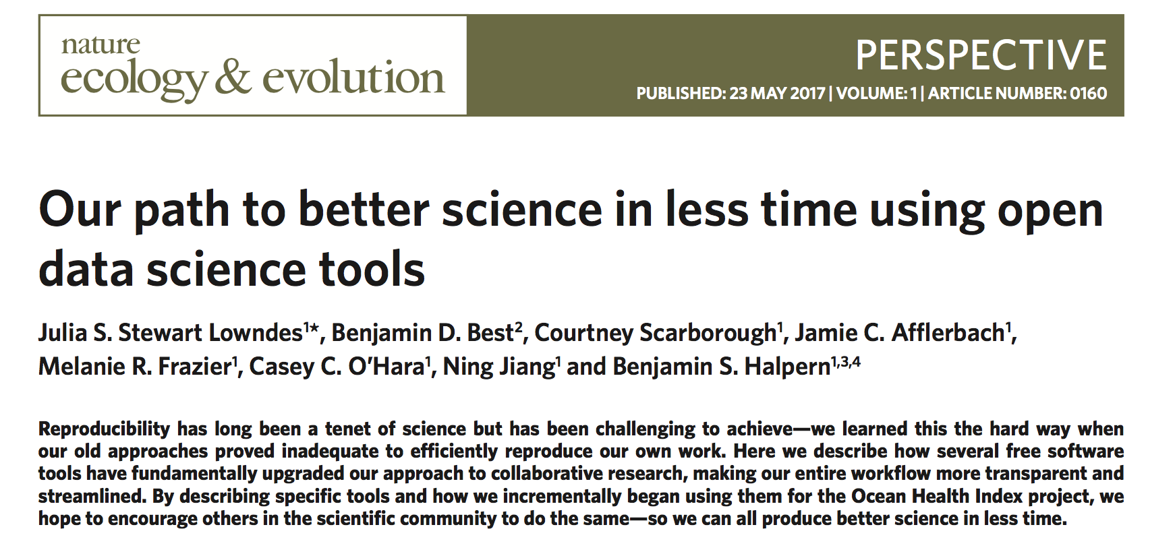

Slide 16
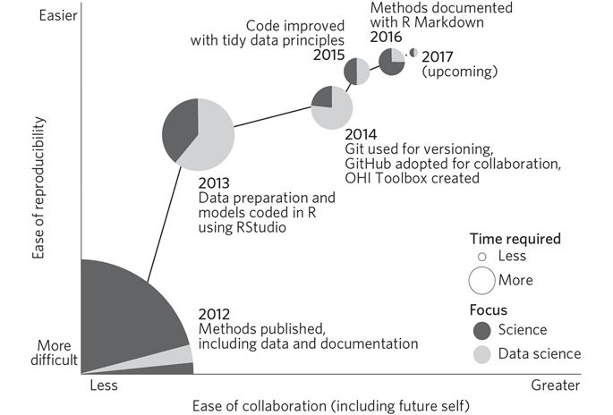

Slide 17
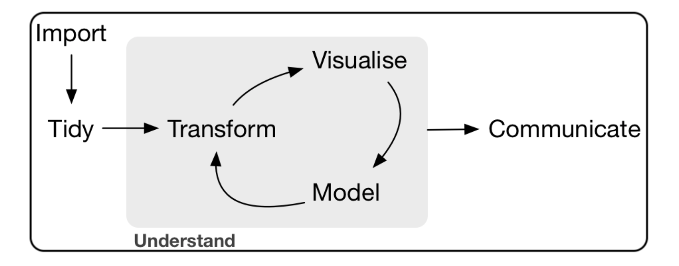
Open data science is a mindset
Expect a better way
Data science is the discipline of turning raw data into understanding
Build confidence & willingness:
Open science is the concept of transparency at all stages of the research process, coupled with free and open access to data, code and papers

Slide 18
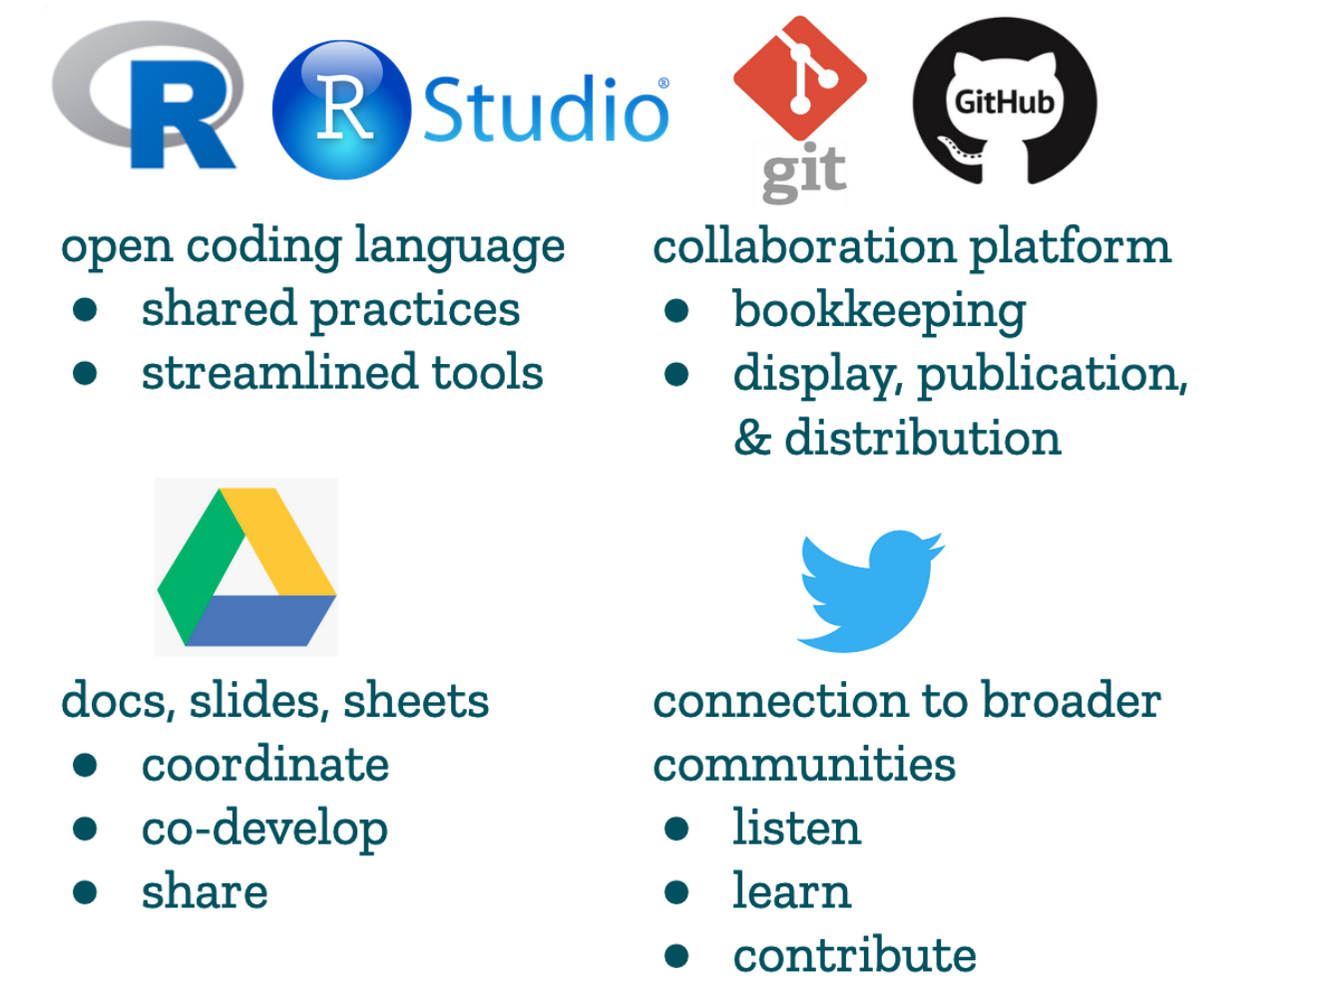
Open data science is a mindset
Reimagine science communication

Slide 19
Teamwork starts with openness
Working openly
Vertical & horizontal leadership
Community

Slide 20
Thank you all!

